Slide 1

RentVault
Rent without the gamble.
Nomba Hackathon

Slide 2

The Problem
Nigeria's rental market runs on trust — because there is no system to verify it. Tenants pay one or two years' rent upfront, often their entire savings, in a single bank transfer. Once paid, there is no mechanism to reverse the transaction if the recipient is fraudulent.
Fake Agents
Double Deposits
Listing properties they do not control, collecting payments and disappearing.
Landlords collecting rent from multiple tenants for the same apartment.
Omo-Onile Disputes
Ownership conflicts that emerge only after payment has been made.

Slide 3

The Solution
RentVault is a Nomba-powered rent escrow platform that replaces assumed trust with verified trust. Funds remain protected until ownership or tenancy has been verified — tenant protection is enforced by the payment infrastructure itself.
Plan
Create
Review
Deliver
Every transition is driven by Nomba webhooks, creating a fully auditable transaction lifecycle without manual intervention.

Slide 4


Why Nomba Is Core to RentVault
RentVault is built around Nomba — not merely integrated with it. Remove any one of these services and the escrow workflow breaks.
Checkout API
Securely collects and holds tenant payments in a tracked escrow state.
Transfers API
Automatically splits escrowed funds between landlords, agents, and RentVault after verification.
Refunds API
Guarantees automatic repayment whenever verification fails or expires.
Webhooks
Synchronizes every payment event with RentVault's engine in real time, ensuring a complete audit trail.

Slide 5




What's Built
RentVault is a working product — not a prototype concept.
Tenant App
Landlord Dashboard
Admin Dashboard
Backend + Data
React + Vite. Browse listings, complete escrow checkout, and track transaction status in real time.
Next.js 14. Manage listings, connect Nomba account, and submit ownership verification.
Next.js 14. Review verification requests, configure payment splits, and view complete audit logs.
Firebase Cloud Functions, Firestore, Storage, and role-based Authentication for all user types.

Slide 6
Example Transaction
₦2,000,000 Apartment
After Verification — Auto-Distributed
A tenant rents an apartment for ₦2,000,000. Payment enters escrow through Nomba Checkout.
If verification fails or expires, the tenant automatically receives the full ₦2,000,000 via Nomba Refunds.
₦1,900,000
₦80,000
Landlord
Agent
₦20,000
RentVault Fee
No manual settlement. No refund requests. Fully automated.

Slide 7

Business Model
RentVault earns a small platform fee on every successfully completed rental transaction. Payment distribution is handled automatically through Nomba Transfers — landlords, agents, and RentVault are all paid in a single settlement process.
Core Revenue
Premium Services
Platform fee on every completed escrow transaction.
Enhanced landlord verification and fraud-risk scoring.
Enterprise Tools
Property management company integrations and bulk transaction tools.

Slide 8
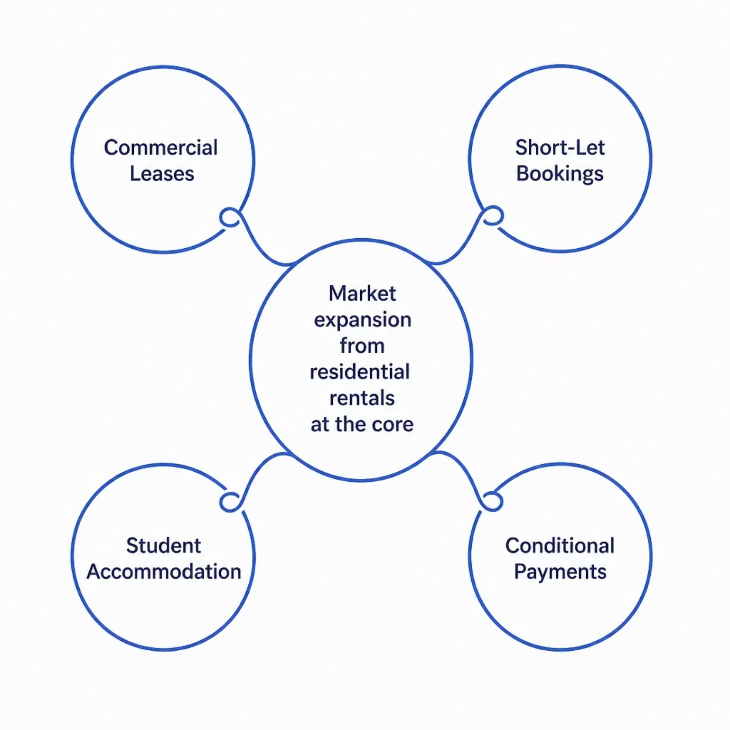

Market Opportunity
Nigeria's rental market is large, largely informal, and increasingly digital in how payments are made — yet trust infrastructure has not evolved alongside digital payments.
RentVault fills this gap by transforming rent payments from trust-based to verification-based transactions.
The same escrow model extends to commercial leases, short-let bookings, student accommodation, and any transaction where payment should only be released after conditions are met.

Slide 9
What's Next
RentVault is already functional end-to-end using Nomba's sandbox environment. The next phase focuses on real-world validation and deeper integrations.
Land Registry Integration
1
Strengthen verification by connecting to land registry data where available.
2
Complex Payment Splits
Support multi-agent transactions and more sophisticated distribution rules.
Lagos Pilot
3
Deploy with real landlords and tenants to validate verification turnaround times under real operating conditions.

Slide 10

Rent Without the Gamble
For years, the advice given to renters in Nigeria has been the same: inspect the property, verify the landlord, and be careful who you pay. RentVault changes the system itself.
Instead of asking tenants to trust first and verify later, RentVault ensures that money moves only after trust has been proven.
Built on Nomba
Powered by Checkout, Transfers, Refunds, and Webhooks.
Powered by Verification
Tenant protection enforced by payment infrastructure.

